Slide 1

LEFT OUTER JOIN
The LEFT JOIN clause allows you to query data from multiple tables. It returns all rows from the left table and the matching rows from the right table. If no matching rows found in the right table, NULL are used.
Infoway Technologies, 3rd Floor Commerce Centre, Rambaug Colony, Paud Road Pune 411038

Slide 2
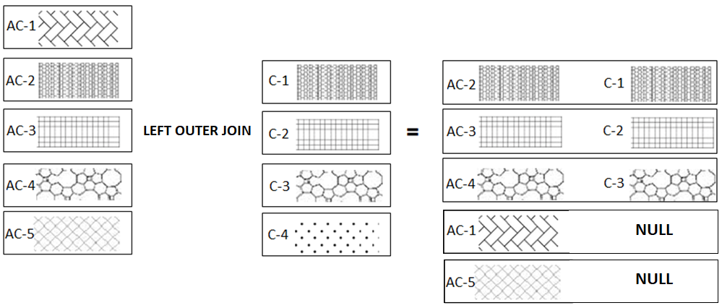
Suppose, we want to join two tables: A and B. SQL left outer join returns all rows in the left table (A) and all the matching rows found in the right table (B). It means the result of the SQL left join always contains the rows in the left table. . If no matching rows found in the right table, NULL are displayed.
The following example the LEFT JOIN of two tables T1(AC-1, AC-2, AC-3, AC-4, AC-5) and T2(C-1, C-2, C-3, C-4). The LEFT JOIN will match rows from the T1 table with the rows from T2 table using patterns:
Infoway Technologies, 3rd Floor Commerce Centre, Rambaug Colony, Paud Road Pune 411038

Slide 3
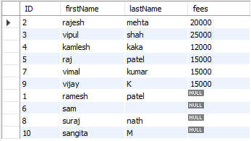
Left Outer Join
syntex
SELECT column-list from <table_references> LEFT [OUTER ] JOIN <table_references> ON table1.column-name = table2.column-name
SELECT student.ID, firstName, lastName, fees FROM student LEFT OUTER JOIN coursefees ON student.ID = coursefees.studentID;

